Slide 1
Functions of Combinational Logic

Slide 2
Agenda
Adders
Comparators
Decoders
Encoders
Multiplexers
Demultiplexers

Slide 3
A combinational circuit is a connected arrangement of logic gates with a set of inputs and outputs.
At any given time, the binary values of the outputs are a function of the binary combination of the inputs
Combinational circuits are employed in digital computers for generating binary control decisions and for providing digital components required for data processing.

Slide 4
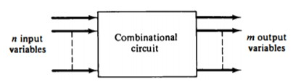
The n binary input variables come from an external source, the m binary output variables go to an external destination, and in between there is an interconnection of logic gates.
A combinational circuit transforms binary information from the given input data to the required output data
A combinational circuit can be described by a truth table showing the binary relationship between the n input variables and the m output variables.

Slide 5
The problem is stated.
The input and output variables are assigned letter symbols.
The truth table that defines the relationship between inputs and outputs is derived.
The simplified Boolean functions for each output are obtained.
The logic diagram is drawn.

Slide 6
Basic Adders
Adders are important in
  computers
  other types of digital systems in which numerical data are processed
We must know about adders.

Slide 7
HALF-ADDER
The most basic digital arithmetic circuit is the addition of two binary digits.
A combinational circuit that performs the arithmetic addition of two bits is called a half-adder.
One that performs the addition of three bits (two significant bits and a previous carry) is called a full-adder.
Two half-adders are needed to implement a full-adder

Slide 8
HALF-ADDER
The input variables of a half-adder are called the augend and
addend bits.
The output variables are the sum and carry
The S output represents the least significant bit of the sum
The C output(Most significant bit) is 0 unless both inputs are 1.
X | Y | C | S
0 | 0 | 0 | 0
0 | 1 | 0 | 1
1 | 0 | 0 | 1
1 | 1 | 1 | 0
Truth table

Slide 9
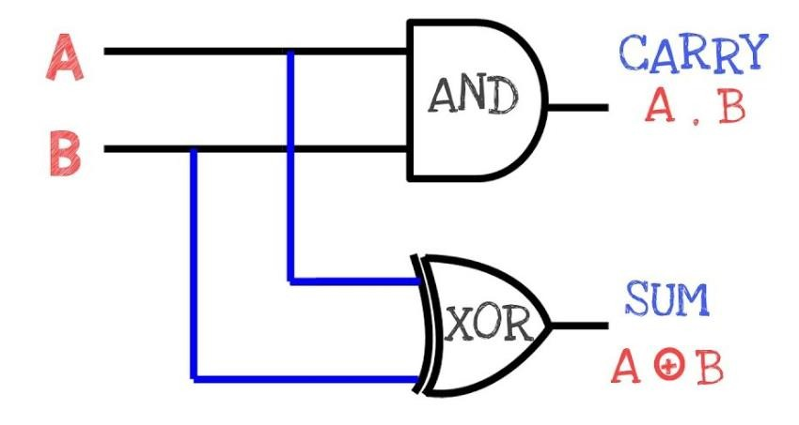

HALF-ADDER
X | Y | C | S
0 | 0 | 0 | 0
0 | 1 | 0 | 1
1 | 0 | 0 | 1
1 | 1 | 1 | 0
X
X.Y
Y
Truth table
The Boolean functions for the two outputs can be obtained directly from the truth table:
S = x'y + xy' = x ⊕ y
c = xY
X ⊕Y
The logic diagram consists of an exclusive-OR gate and an AND
gate.

Slide 10

A full-adder is a combinational circuit that forms the arithmetic sum of three input bits.
It consists of three inputs and two outputs.
Two of the input variables, denoted by x and y, represent the two significant bits to be added.
The third input, z represents the carry from the previous lower significant position
The two outputs are designated by the symbols S (for sum) and C (for carry).
The binary variable S gives the value of the least significant bit of the sum.
The binary variable C gives the output carry

Slide 11

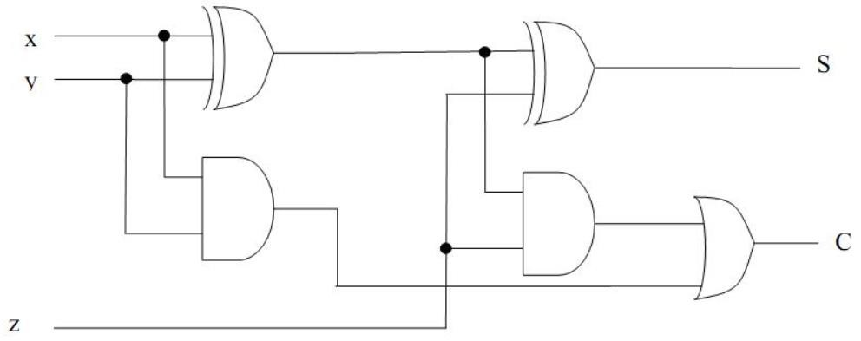
Truth table
Sum =x’y’z+x’yz’+xy’z’+xyz
= x ⊕y ⊕z
Carry= x’yz+xy’z+xyz’+xyz
=z(x’y+xy’)+xy(z’+z)
= (x ⊕y )z+xy
Inputs |  |  | Outputs
X | Y | Z | Carry | Sum
0 | 0 | 0 | 0 | 0
0 | 0 | 1 | 0 | 1
0 | 1 | 0 | 0 | 1
0 | 1 | 1 | 1 | 0
1 | 0 | 0 | 0 | 1
1 | 0 | 1 | 1 | 0
1 | 1 | 0 | 1 | 0
1 | 1 | 1 | 1 | 1
x ⊕y ⊕z
(x ⊕y )z+xy

Slide 12
Basic Adders
Adders are important in
  computers
  other types of digital systems in which numerical data are processed
We must know about adders.

Slide 13
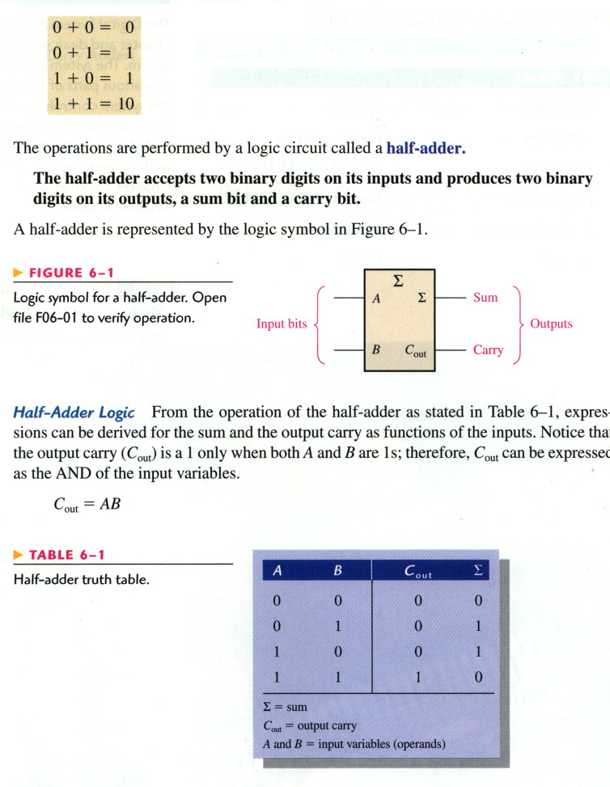
The Half-Adder
Basic rule for binary addition.
The operations are performed by a logic ckt called a half-adder.

Slide 14
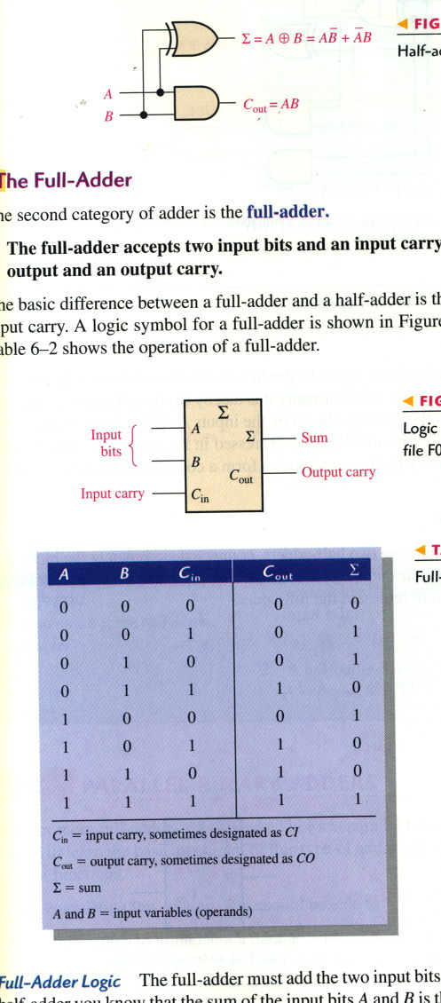
The Half-Adder
The half-adder accepts two binary digits on its inputs and produces two binary digits on its outputs, a sum bit and a carry bit.

Slide 15
The Full-Adder
The full-adder accepts two input bits and an input carry and generates a sum output and an output carry.

Slide 16
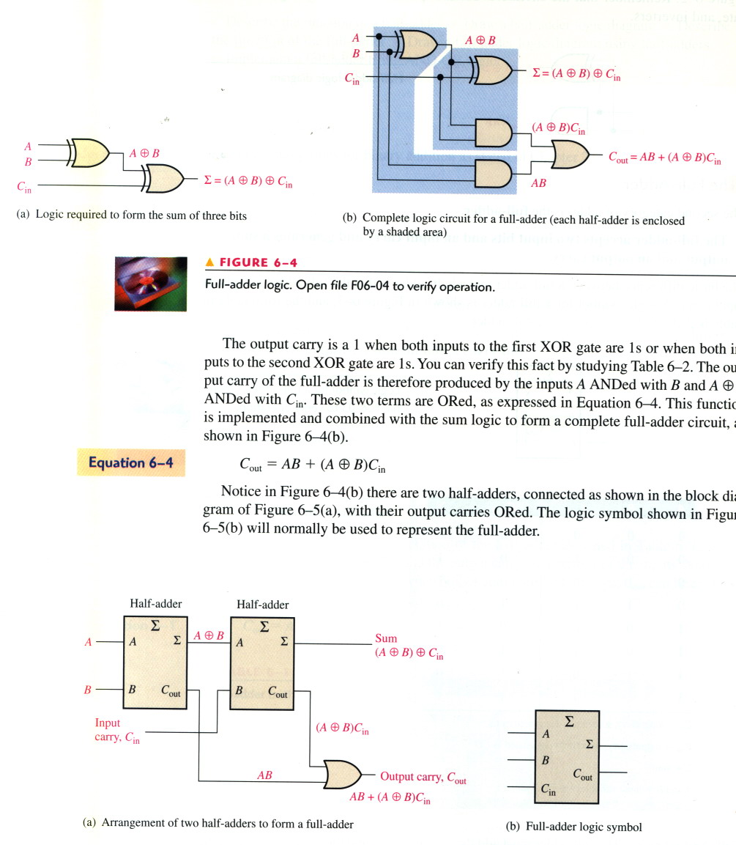
Full-Adder Logic

Slide 17
The Full-Adder

Slide 18
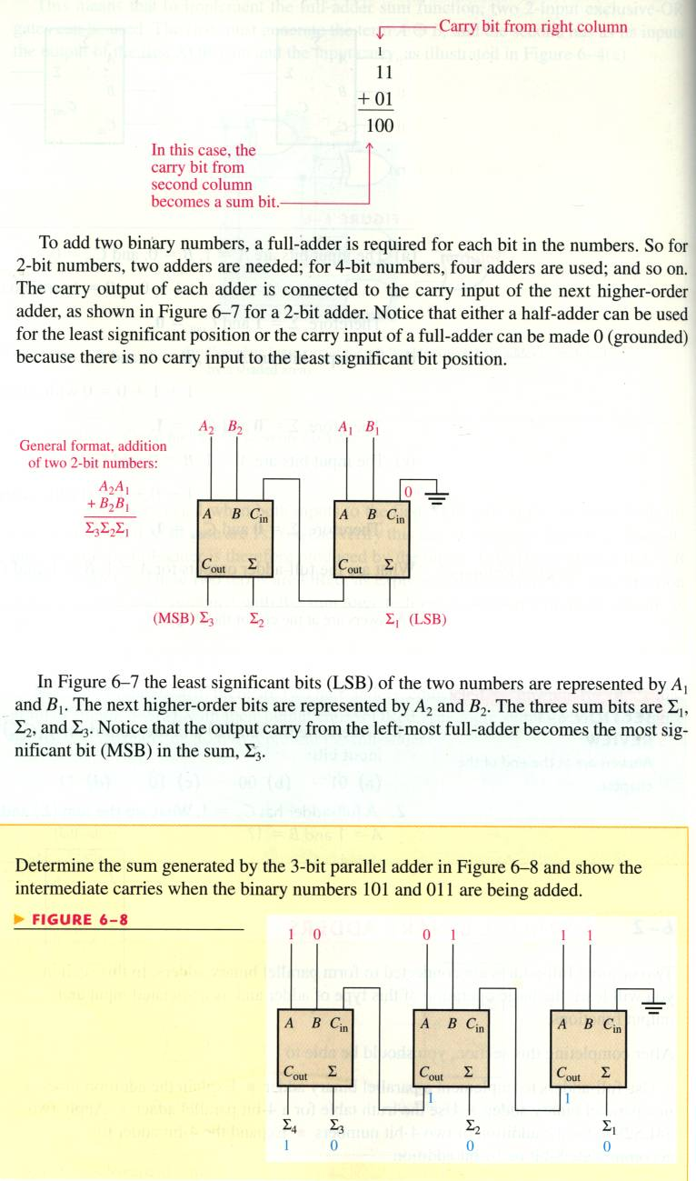
Parallel Binary Adders
Two or more full adders are connected to form parallel binary adders.
  To add two binary numbers, a full-adder is required for each bit in the numbers.
  So, for 2-bit numbers, two adders are needed.

Slide 19
Parallel Binary Adders
The carry output of each adder is connected to the carry input of the next higher-order adder.

Slide 20
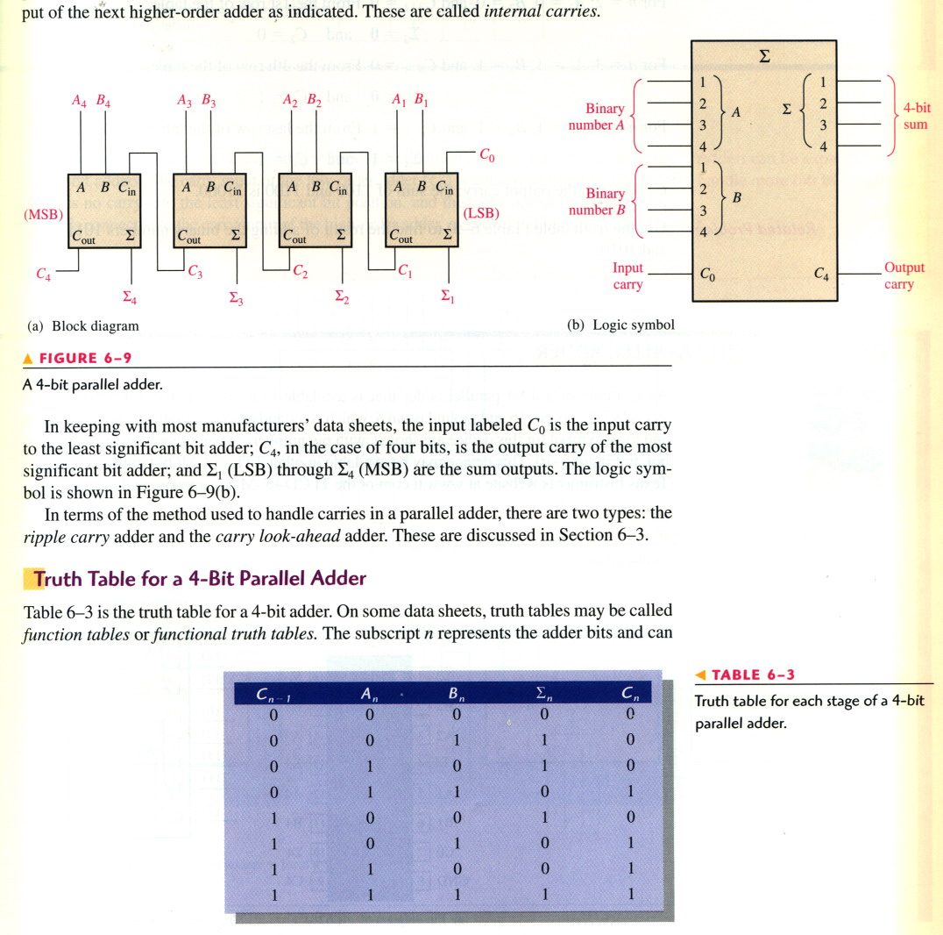
Four-Bit Parallel Adders
A group of 4 bits is called a nibble. A basic 4-bit parallel adder is implemented with four full-adder stages as shown.

Slide 21
Four-Bit Parallel Adders
The carry output of each adder is connected to the carry input of the next higher-order adder as indicated. These are called internal carries.

Slide 22
The Half Subtractor is a digital circuit which processes the subtraction of two 1-bit numbers.
In the subtraction procedure, the subtrahend will be subtracted from minuend.
The circuit of Half subtractor consists of two inputs and two outputs.
The inputs of the half subtractor circuit will be subtrahend and
minuend.
The output will be the difference and the borrow.

Slide 23
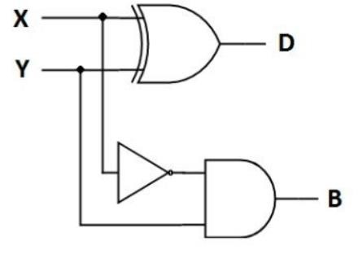
Truth table
Difference =x’y+xy’
= x ⊕y Borrow= x’y
X | Y | D | B
0 | 0 | 0 | 0
0 | 1 | 1 | 1
1 | 0 | 1 | 0
1 | 1 | 0 | 0
x ⊕y
x’y

Slide 24
A full subtractor is a combinational circuit that performs subtraction of two bits, one is minuend and other is subtrahend, taking into account borrow of the previous adjacent lower minuend bit.
This circuit has three inputs and two outputs.
The three inputs A, B and Bin, denote the minuend, subtrahend, and previous borrow, respectively.
The two outputs, D and Bout represent the difference and output borrow, respectively.

Slide 25
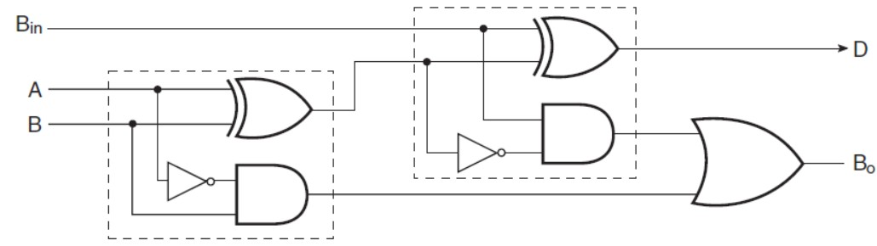

Truth table
Difference=A’B’B_{in}+A’BB_{in}’+AB’B_{in}’+ABB_{in}
=A ⊕ B ⊕ B_{in}
Borrow= A’B’B_{in}+ A’BB_{in}’+A’BB_{in} +ABB_{in}
= A’B’B_{in}+A’B(B_{in}’+B_{in} )+ ABB_{in}
= A’B +A’B’B_{in} + ABB_{in}
= A’B +(A’B’+ AB)B_{in}
= A’B +(A ⊕ B )’B_{in}
Inputs |  |  | Outputs
A | B | Bin | D | Bout
0 | 0 | 0 | 0 | 0
0 | 0 | 1 | 1 | 1
0 | 1 | 0 | 1 | 1
0 | 1 | 1 | 0 | 1
1 | 0 | 0 | 1 | 0
1 | 0 | 1 | 0 | 0
1 | 1 | 0 | 0 | 0
1 | 1 | 1 | 1 | 1
A ⊕ B ⊕ B_{in}
A’B +(A ⊕ B )’B_{in}
A’B

Slide 26
Decoders

Slide 27
Decoders
A decoder detects the presence of a specified combination of bits (code) on its inputs and indicates the presence of that code by a specified output level.
  In its general form, a decoder has n input lines to handle n bits and forms one to 2^{n} output lines to indicate the presence of one or more n-bit combinations.

Slide 28
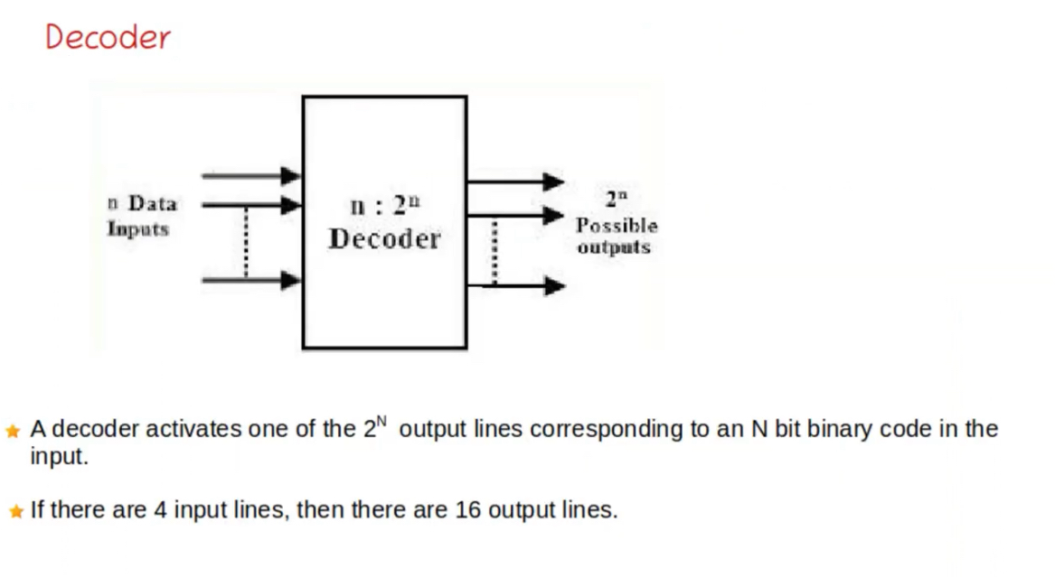

Slide 29
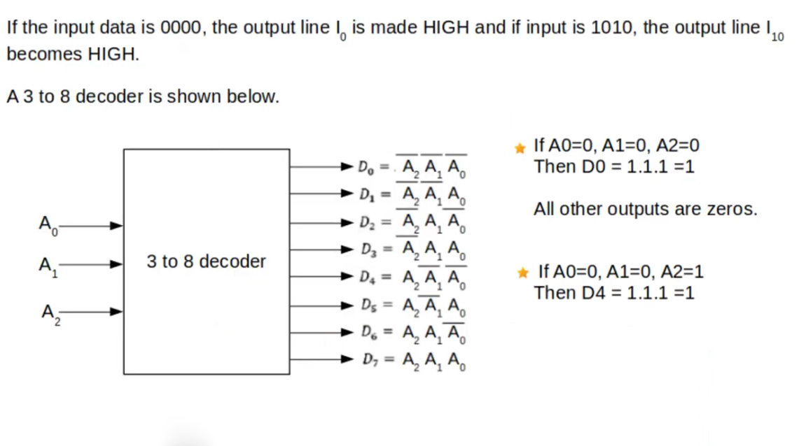

Slide 30
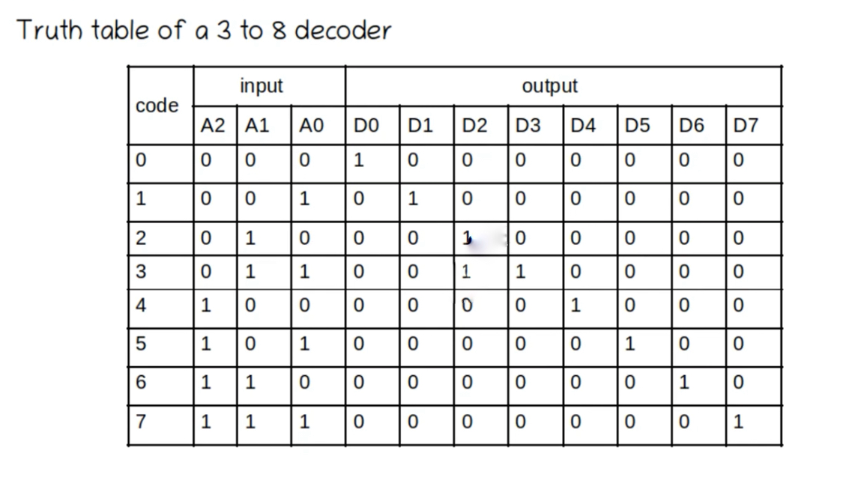

Slide 31
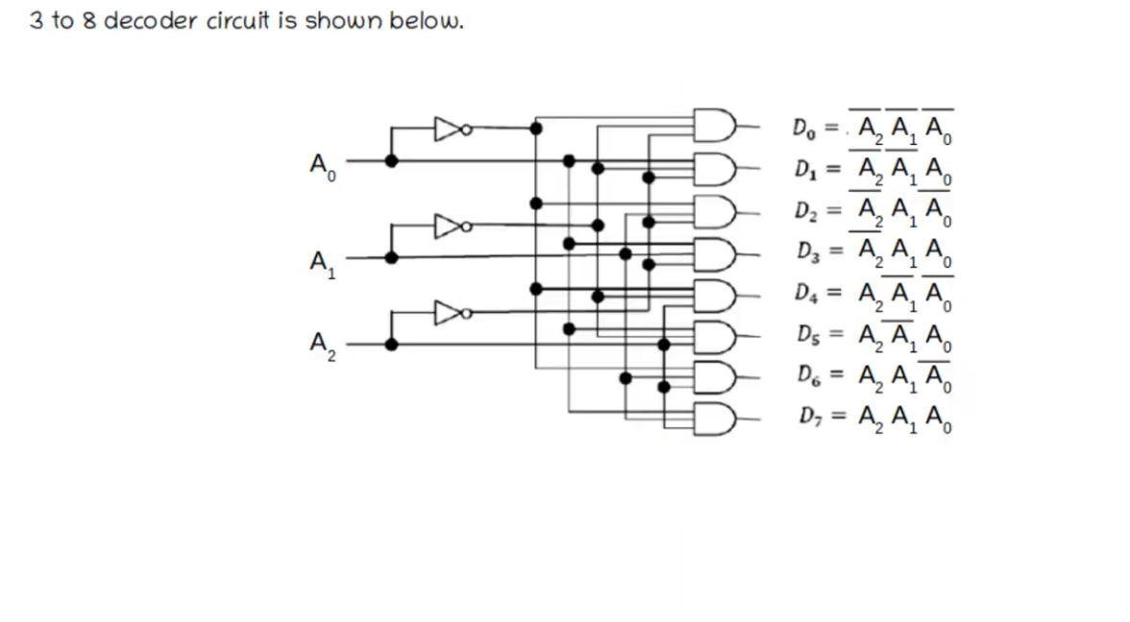

Slide 32
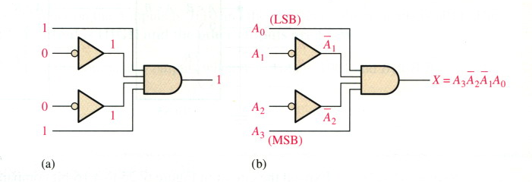
The Basic Binary Decoder
Suppose we need to determine when a binary 1001 occurs on the inputs of a digital ckt.

Slide 33
The 4-Bit Decoder
In order to decode all possible combinations of four bits, 16 decoding gates are required (2⁴=16).
This type of decoder is commonly called either:
  A 4-line-to-16-line decoder, or
  A 1-of-16 decoder
Decoding functions and truth table for a 4-line-to-16-line decoder with active-LOW outputs → see the next slide.

Slide 34
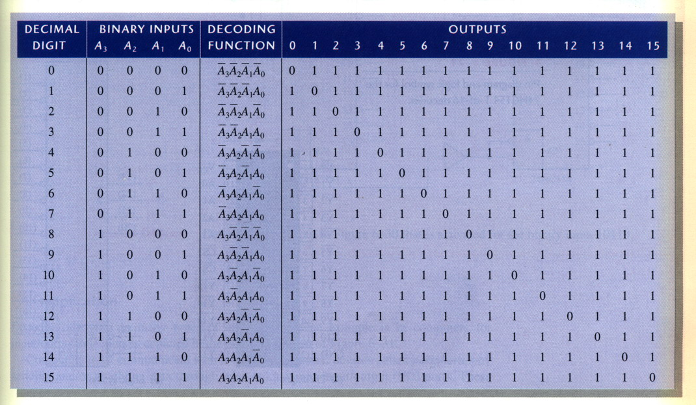
The 4-Bit Decoder

Slide 35
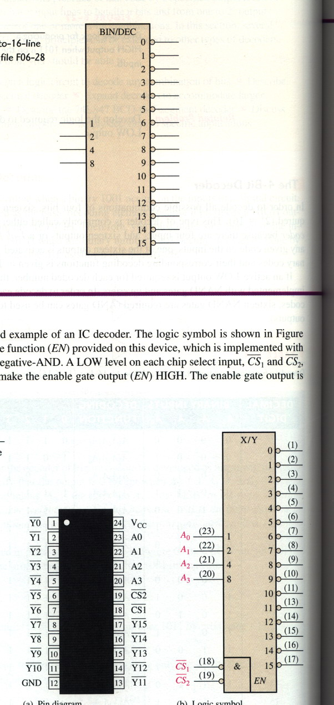
The 4-Bit Decoder
74HC154: 1-of-16 decoder

Slide 36
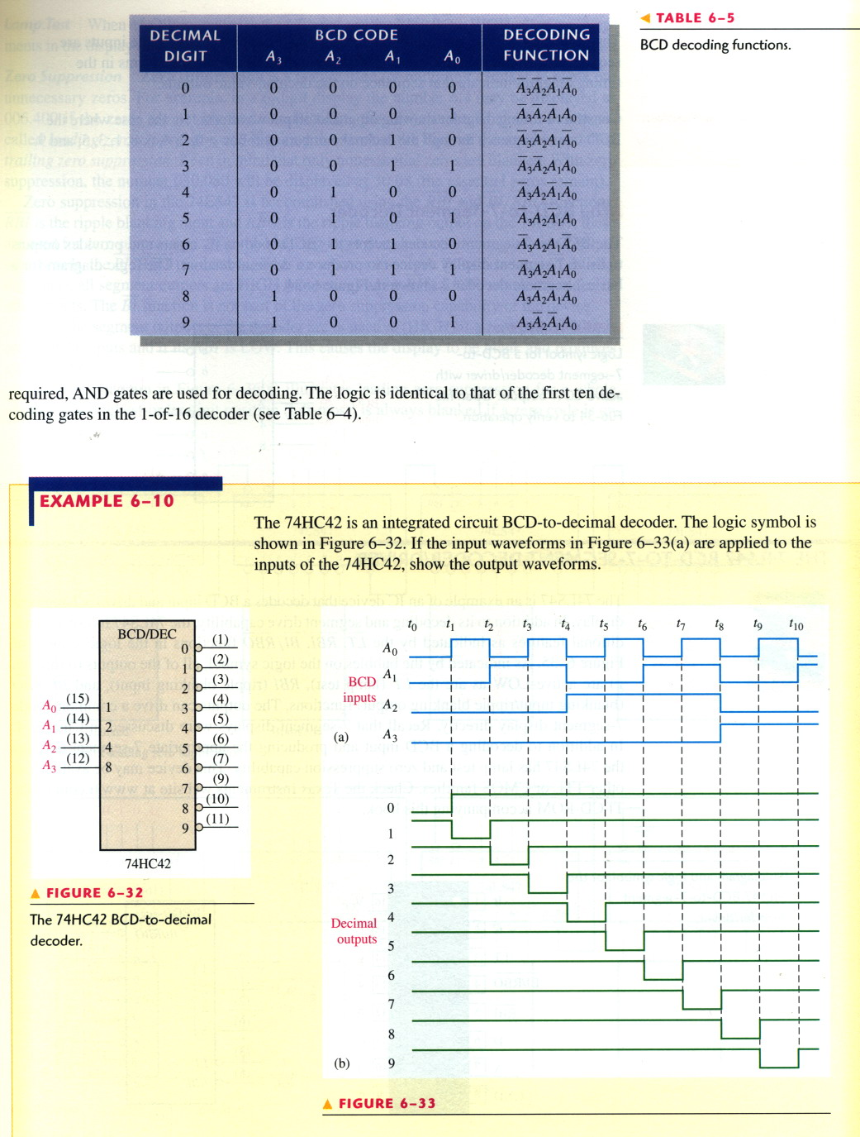
The BCD-to-Decimal Decoder
The BCD-to-decimal converts each BCD code into one of ten possible decimal digit indications.
Called → 4-line-to-10-line decoder or 1-of-10 decoder

Slide 37
The BCD-to-Decimal Decoder

Slide 38
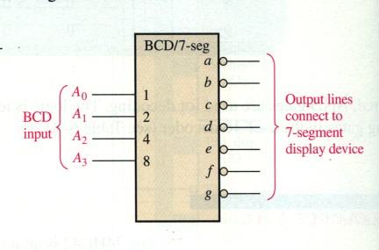
The BCD-to-7-Segment Decoder
The BCD-to-7-segment decoder accepts the BCD code on its inputs and provides outputs to drive 7-segment display devices to produce a decimal readout.

Slide 39
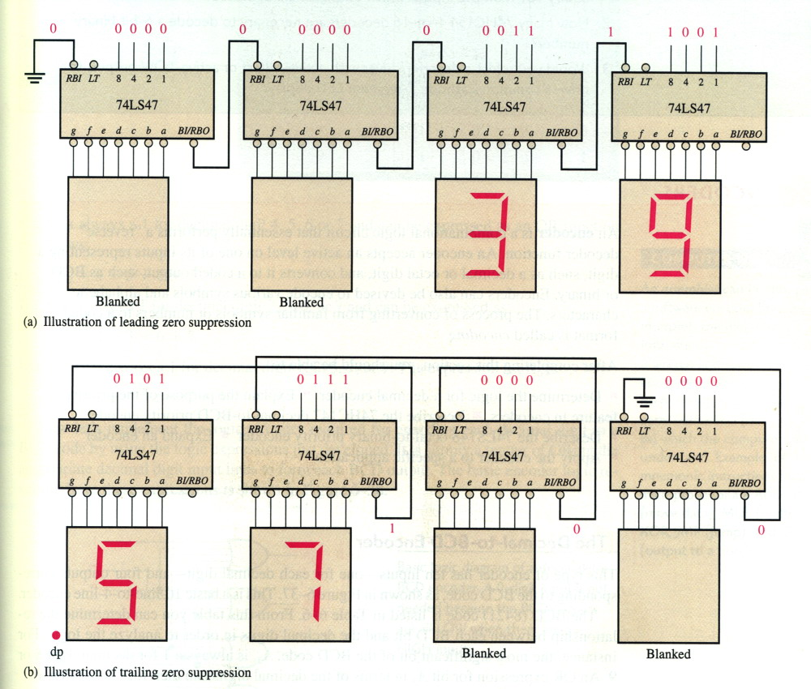
The BCD-to-7-Segment Decoder (The Application)

Slide 40
Encoders

Slide 41
Encoders
An encoder is a combinational logic ckt that essentially performs a “reverse” decoder function.
An encoder accepts an active level on one of its inputs representing a digit, such as a decimal or octal digit, and converts it to a coded output such as BCD or binary.
Encoders can also be devised to encode various symbols and alphabetic characters.

Slide 42
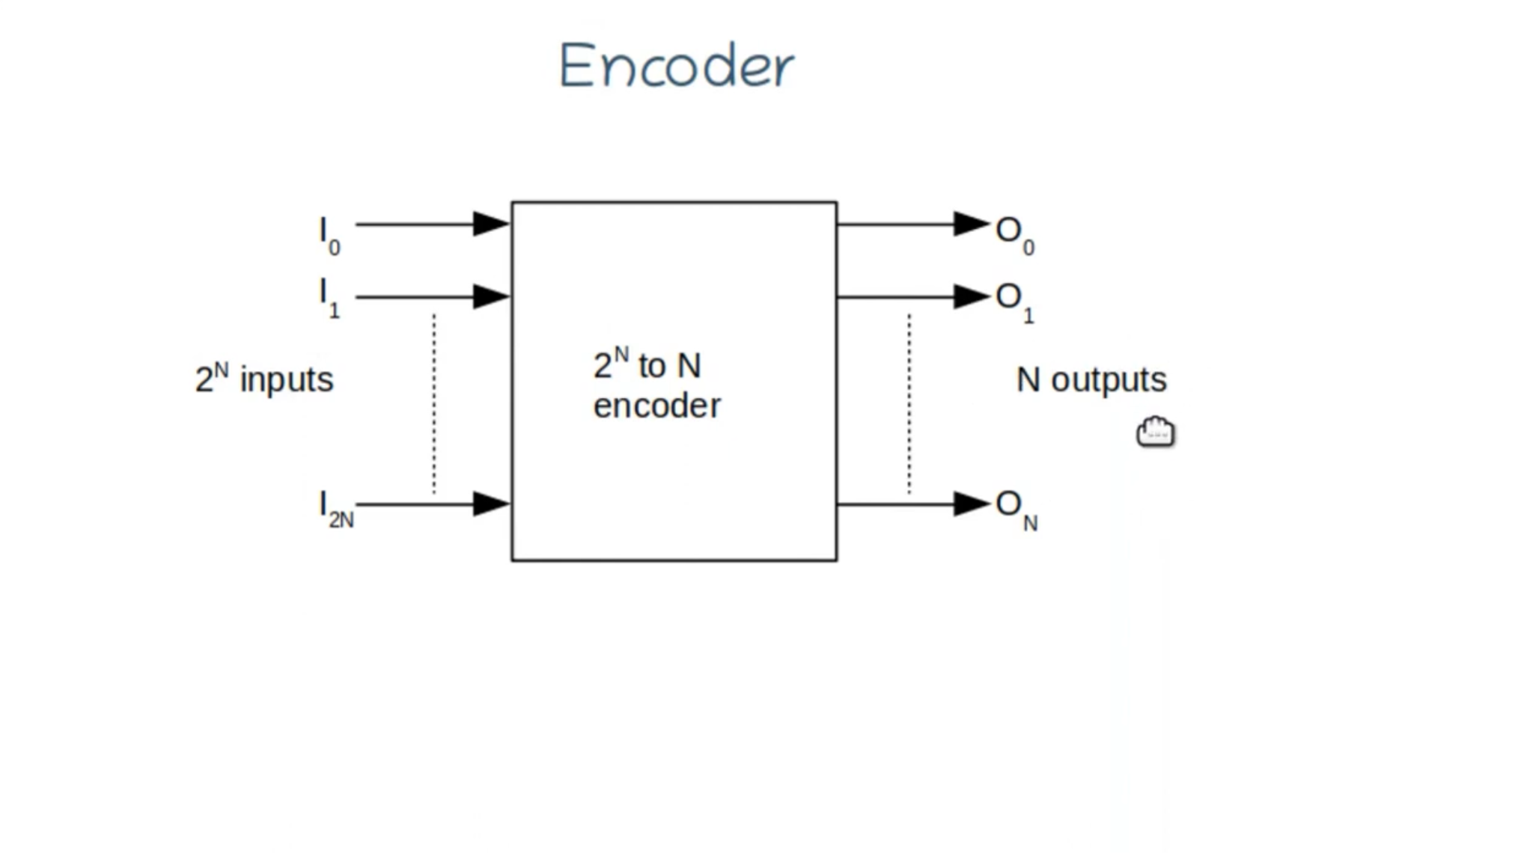

Slide 43
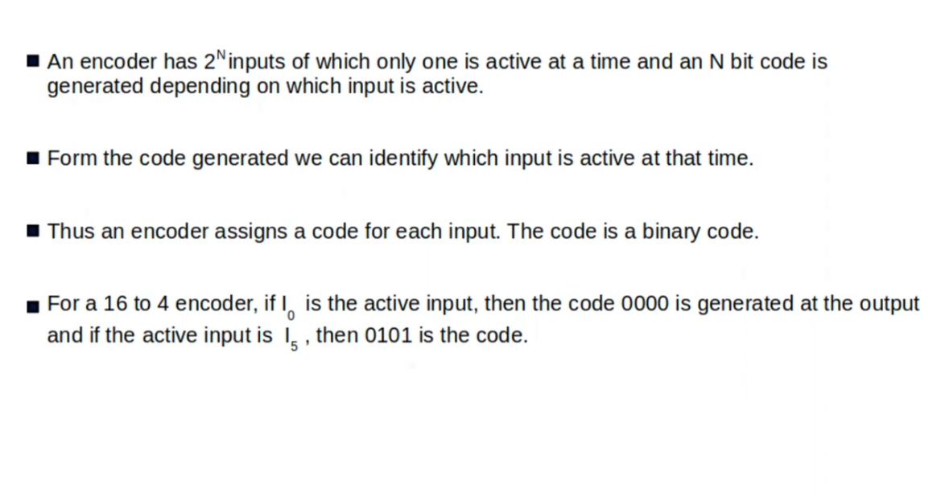

Slide 44
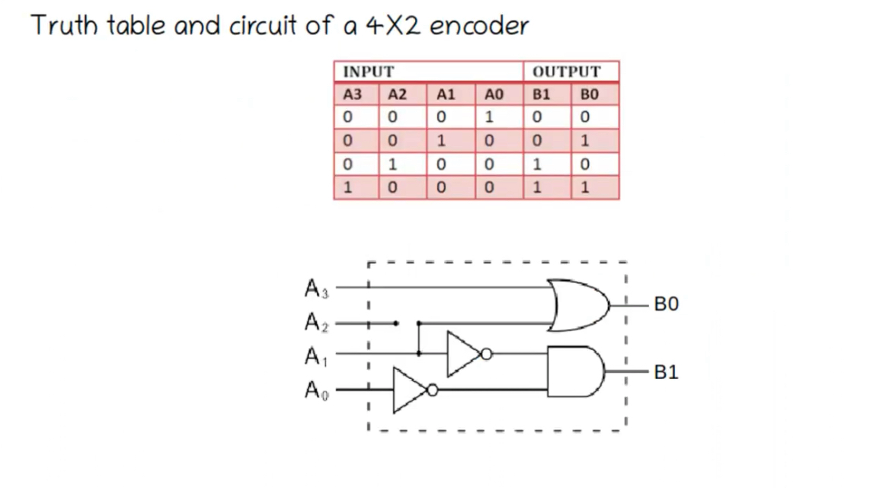

Slide 45
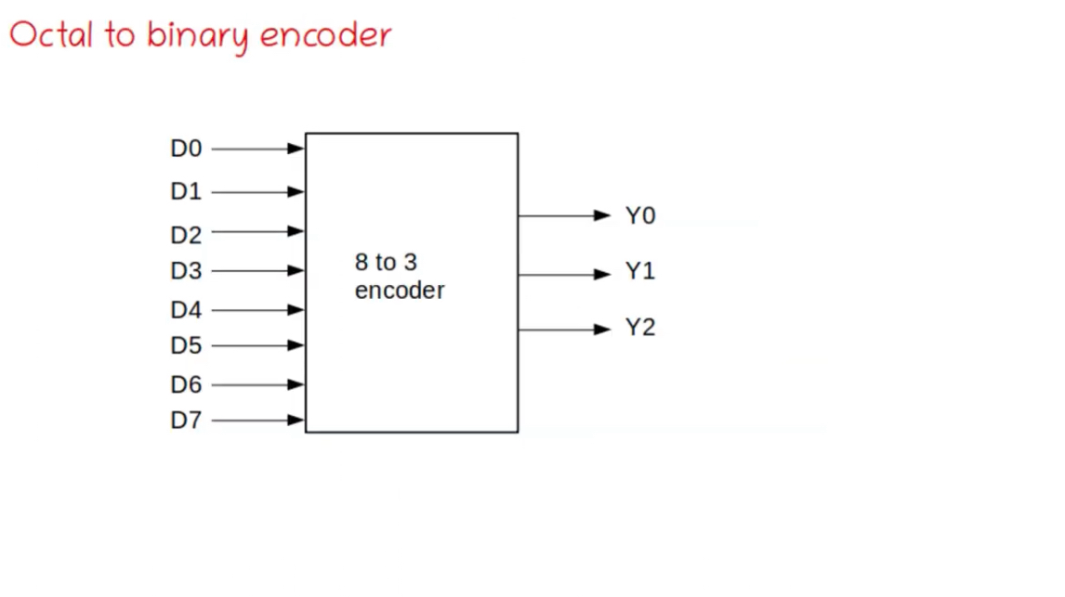

Slide 46
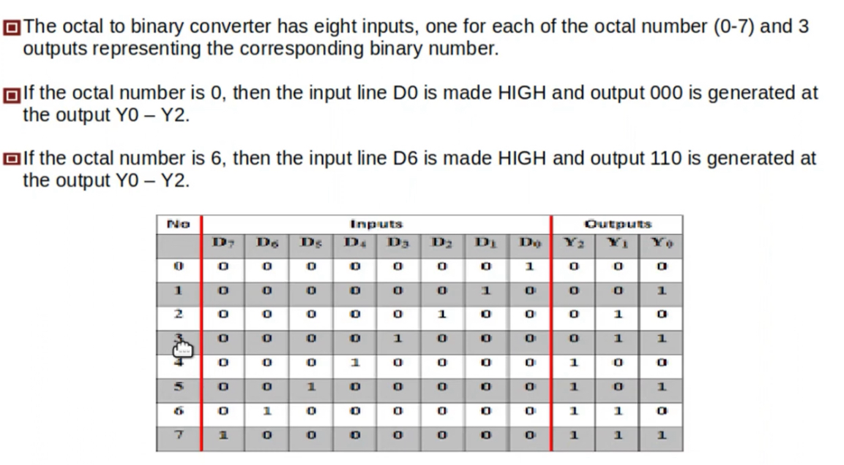

Slide 47
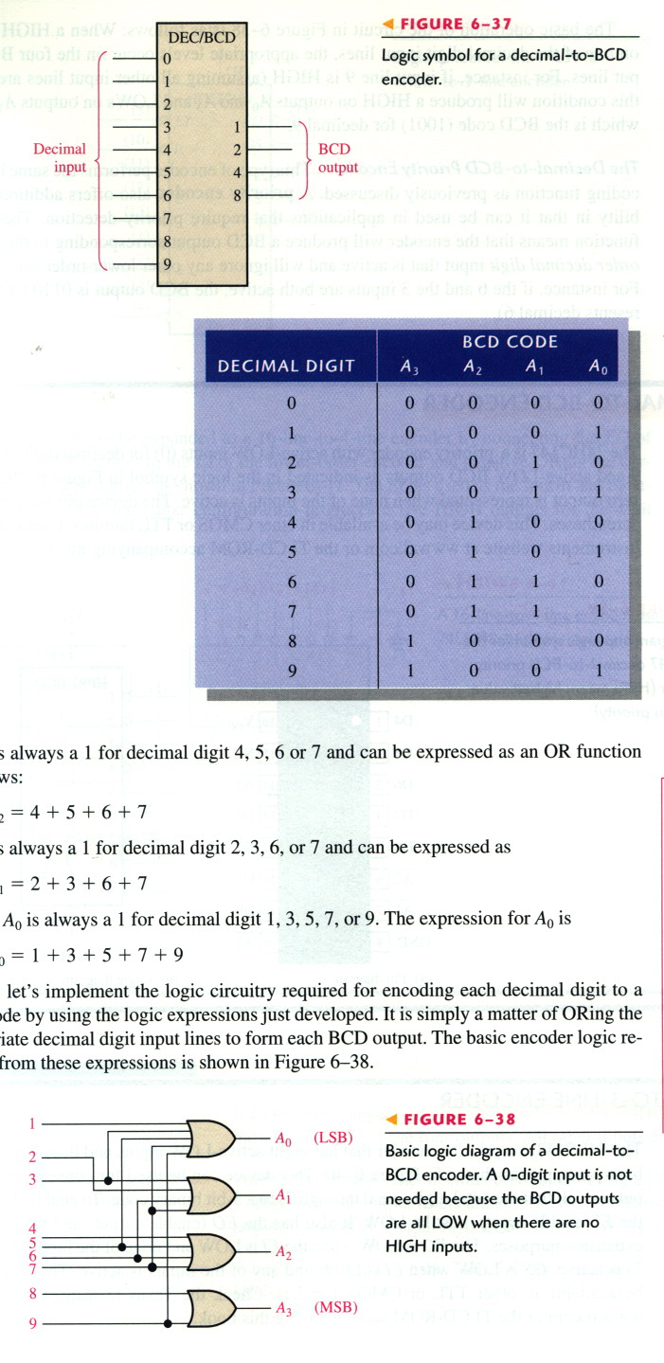
The Decimal-to-BCD Encoder
It has 10 inputs and 4 outputs corresponding to the BCD code.
  A₃ = 8+9
  A₂ = 4+5+6+7
  A₁ = 2+3+6+7
  A₀ = 1+3+5+7+9

Slide 48
The Decimal-to-BCD Encoder
NOTE: A 0-digit input is not needed because the BCD outputs are all LOW when there are no HIGH input.

Slide 49
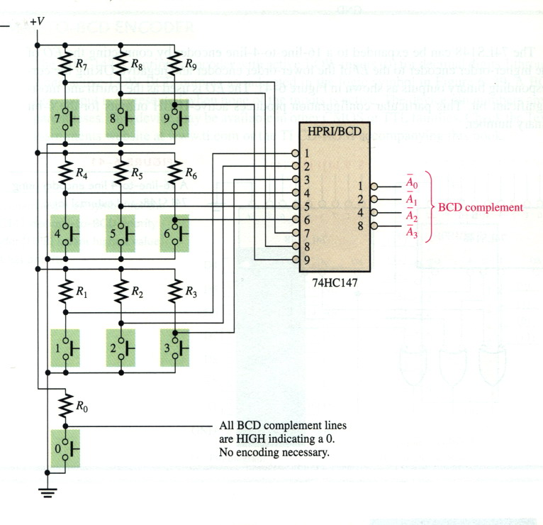
The Decimal-to-BCD Encoder (The Application)

Slide 50
Multiplexers

Slide 51
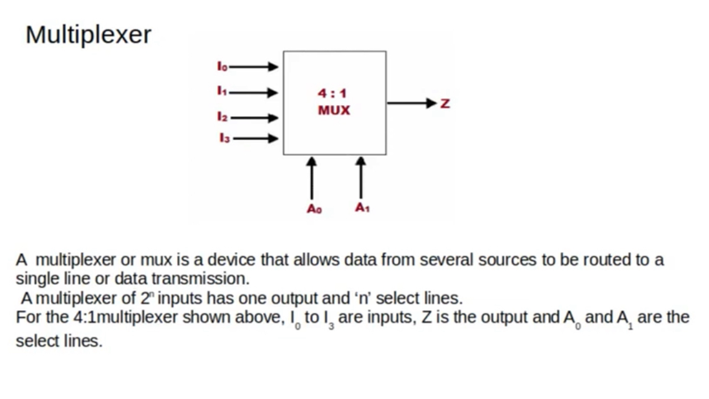

Slide 52
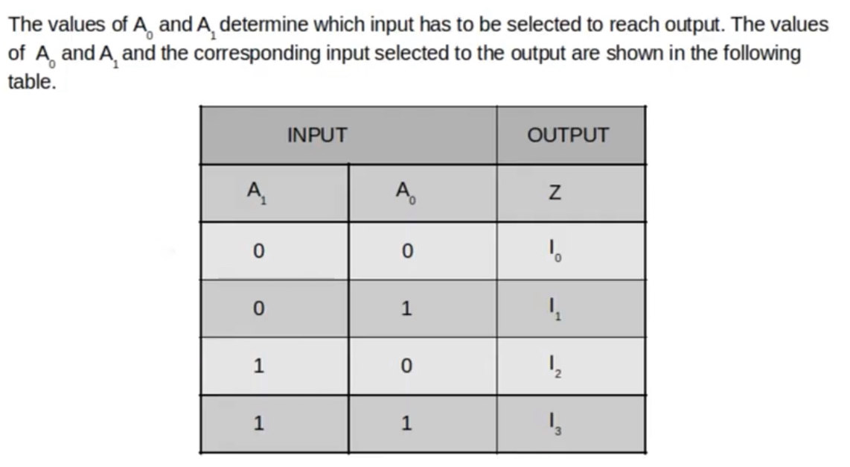

Slide 53
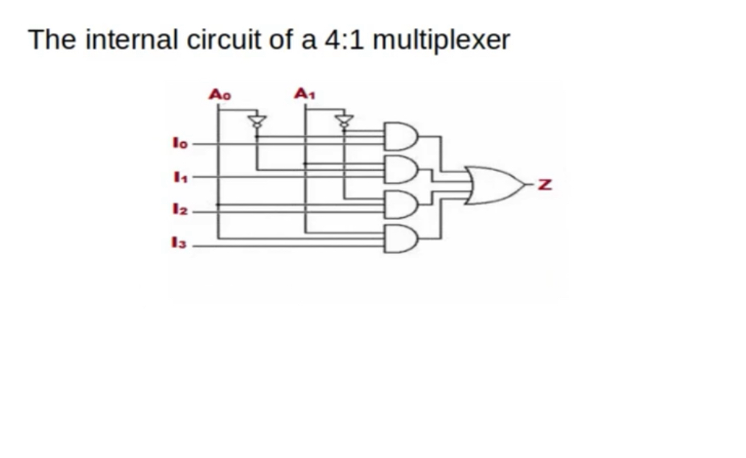

Slide 54
Multiplexers (Data Selectors)
A MUX is a device that allows digital information from several sources to be routed onto a single line for data transmission over that line to a common destination.
The basic MUX has several data-input lines and a single output line.
It also has data-select inputs, which permit digital data on any one of the inputs to be switched to the output line.

Slide 55
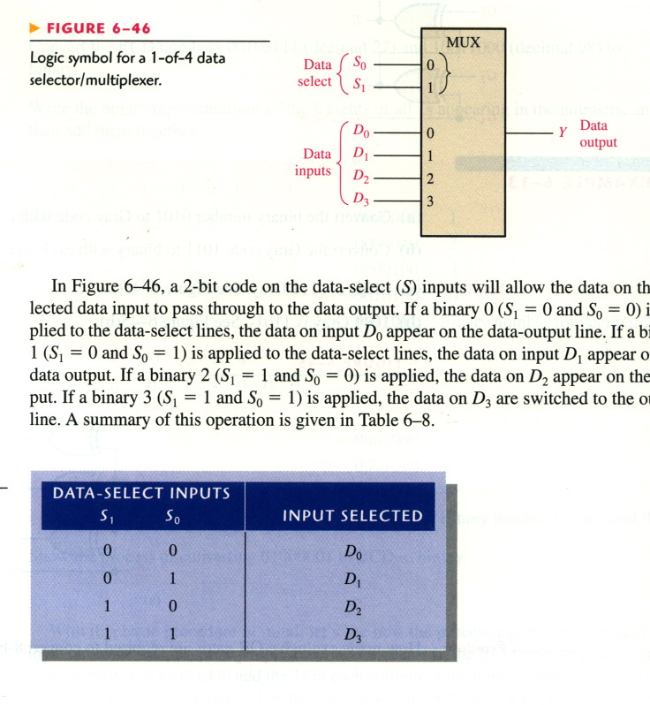
Multiplexers (Data Selectors)

Slide 56
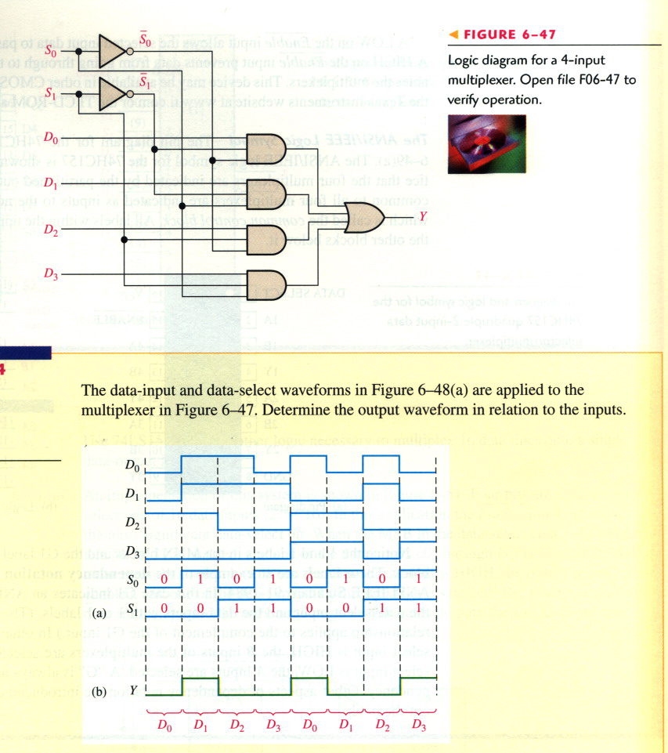
Multiplexers (Data Selectors)

Slide 57
Multiplexers (Data Selectors)

Slide 58
Demultiplexers

Slide 59
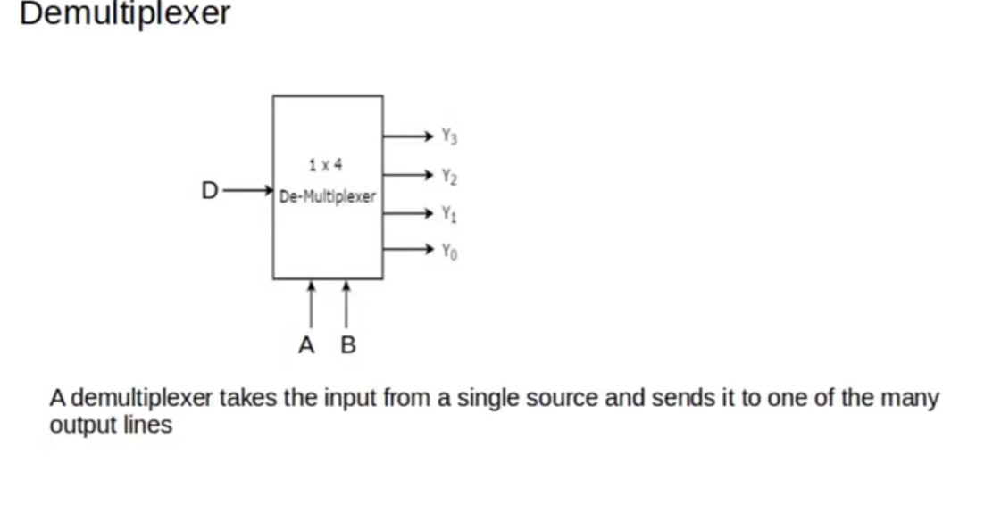

Slide 60
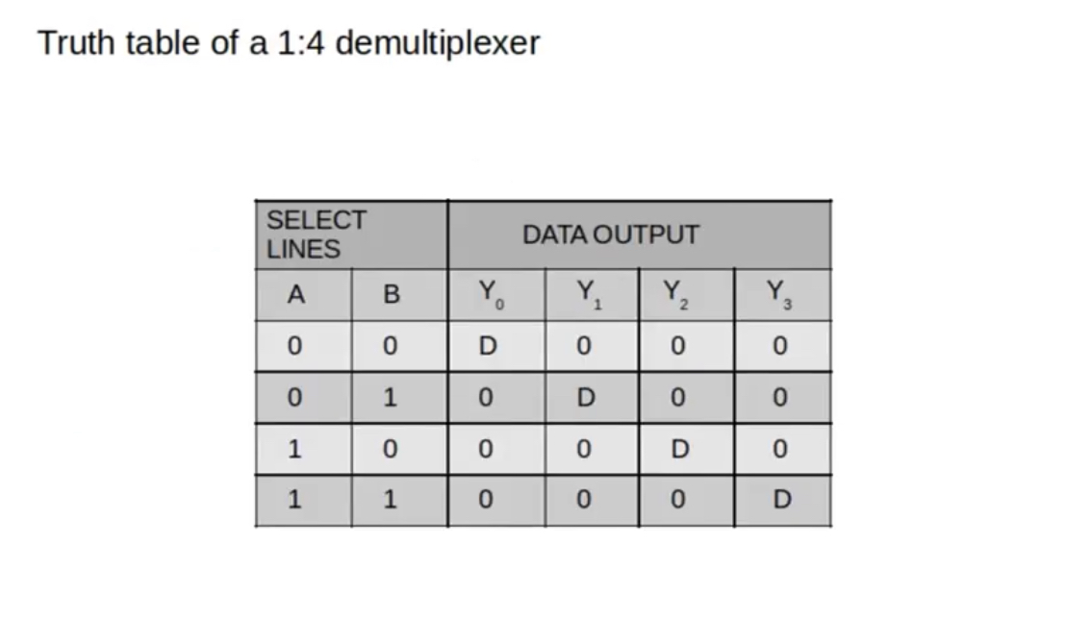

Slide 61
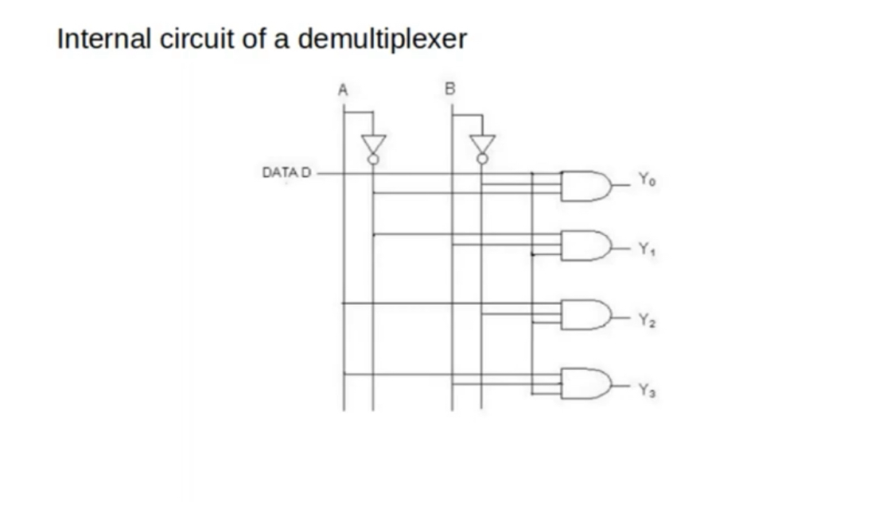

Slide 62
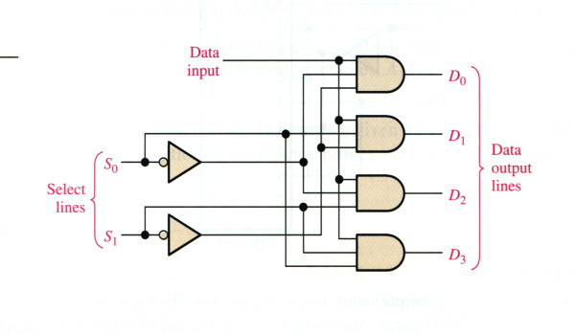
Demultiplexers
A DEMUX basically reverses the MUX function.
  It takes digital information from one line and distributes it to a given number of output lines.
It also known as data distributor.

Slide 63
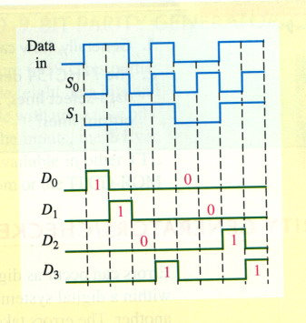
Demultiplexers

